Slide 1
RTX-Explore
DXR Path Tracer
Liam Dugan · Henry Zhu · Ziad Ben Hadj-Alouane

Slide 2
Current Progress

Slide 3
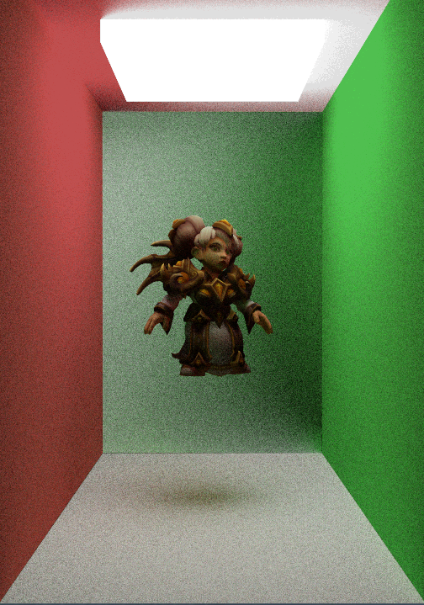
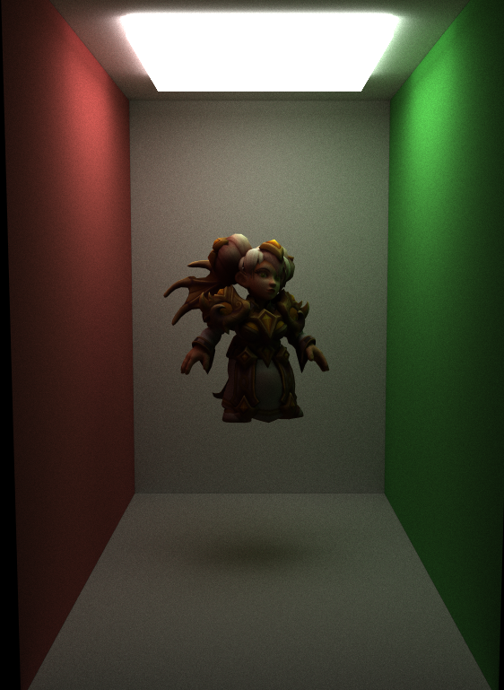
MILESTONE III - Part 1
Path Tracing Improvements

Slide 4
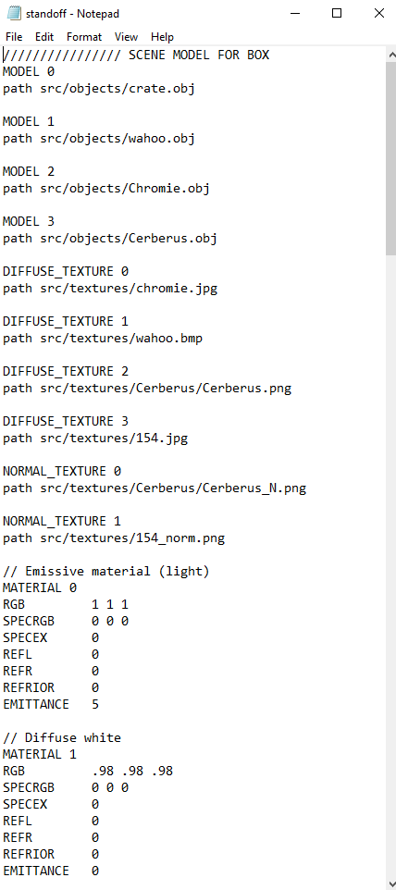
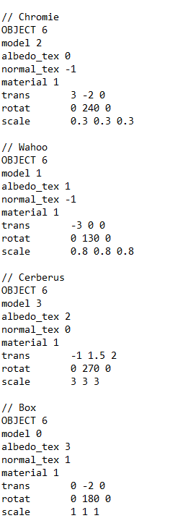
Improvements:
Models can now reference textures/materials in any order in scene file
Scene file rotation/scale matrix now edits normal
Normal maps can be edited from the scene file
Improved RNG function
Improved accumulation of color for better precision
Optimized number of GPU to CPU copies

Slide 5
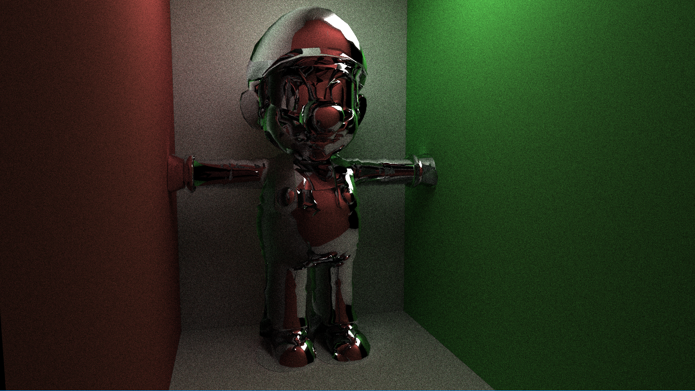

Slide 6
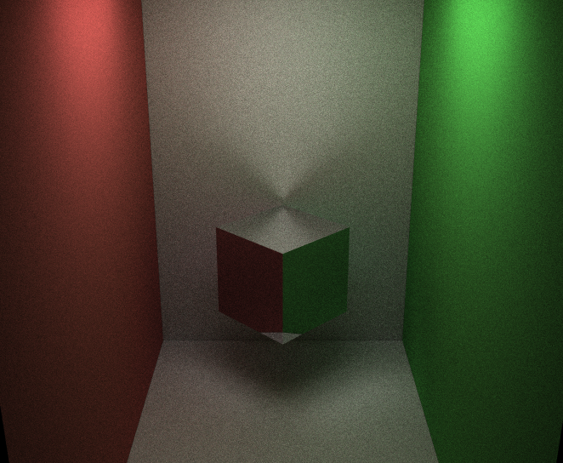
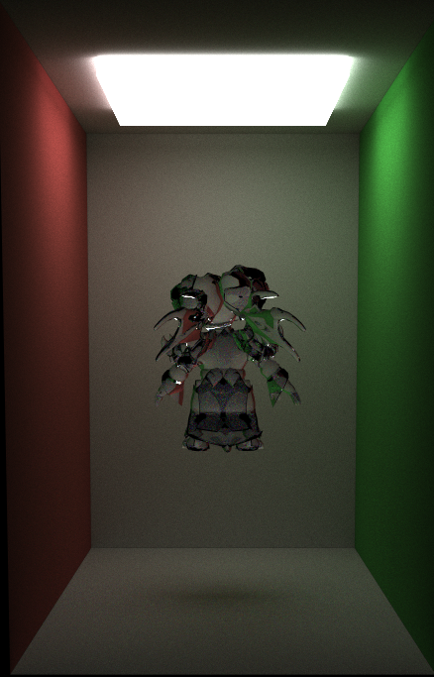

Slide 7
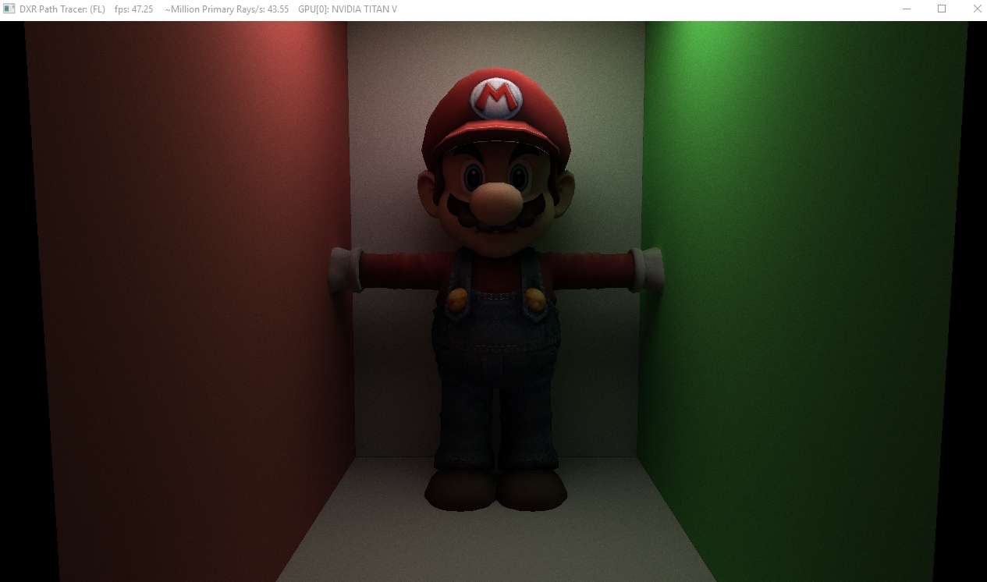

Slide 8
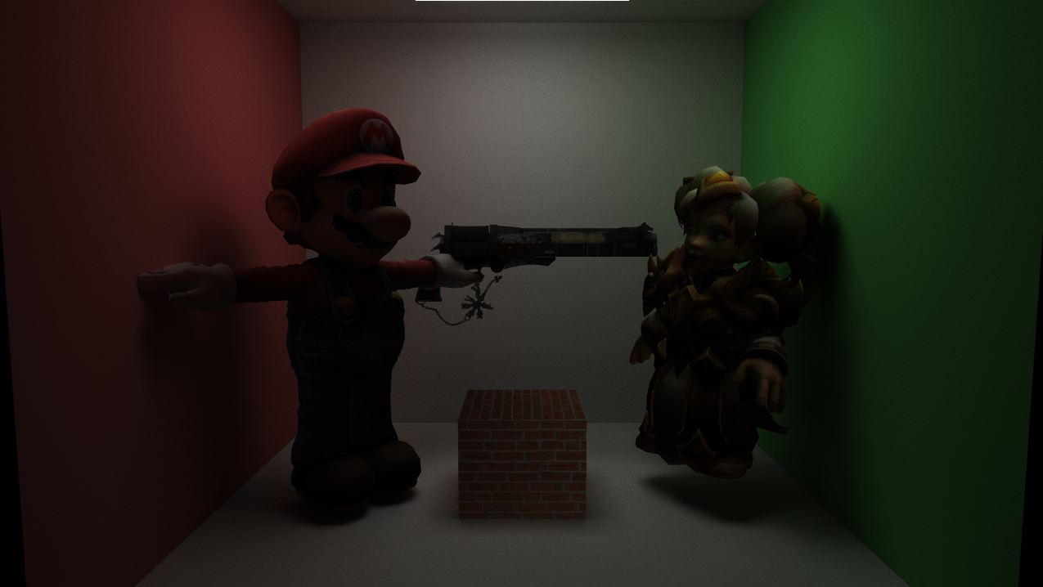

Slide 9
MILESTONE III - Part 2
Glass, Metal, Dispersion

Slide 10
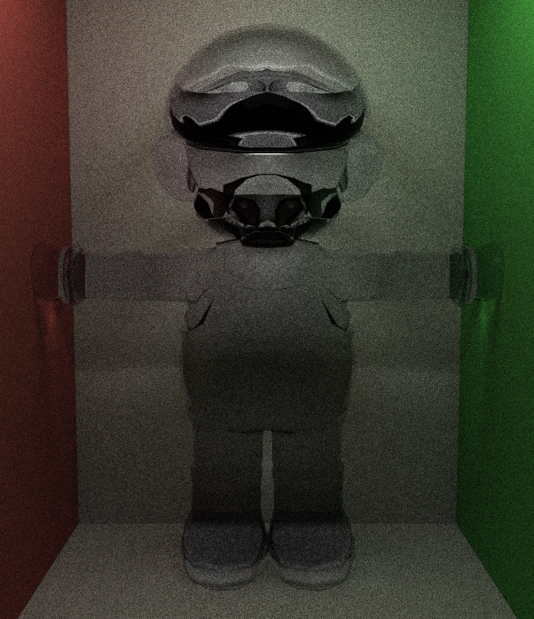
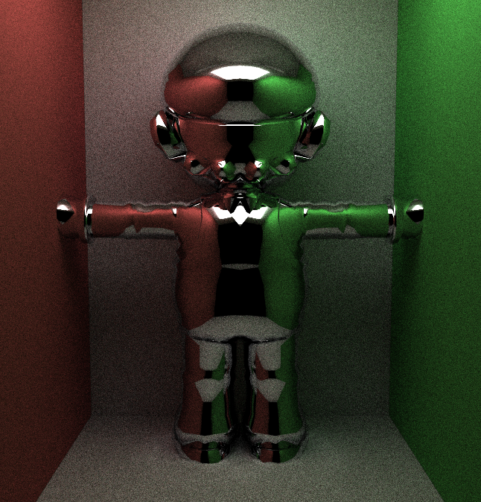
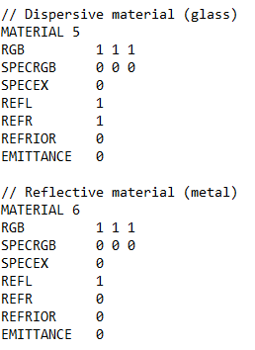

Slide 11
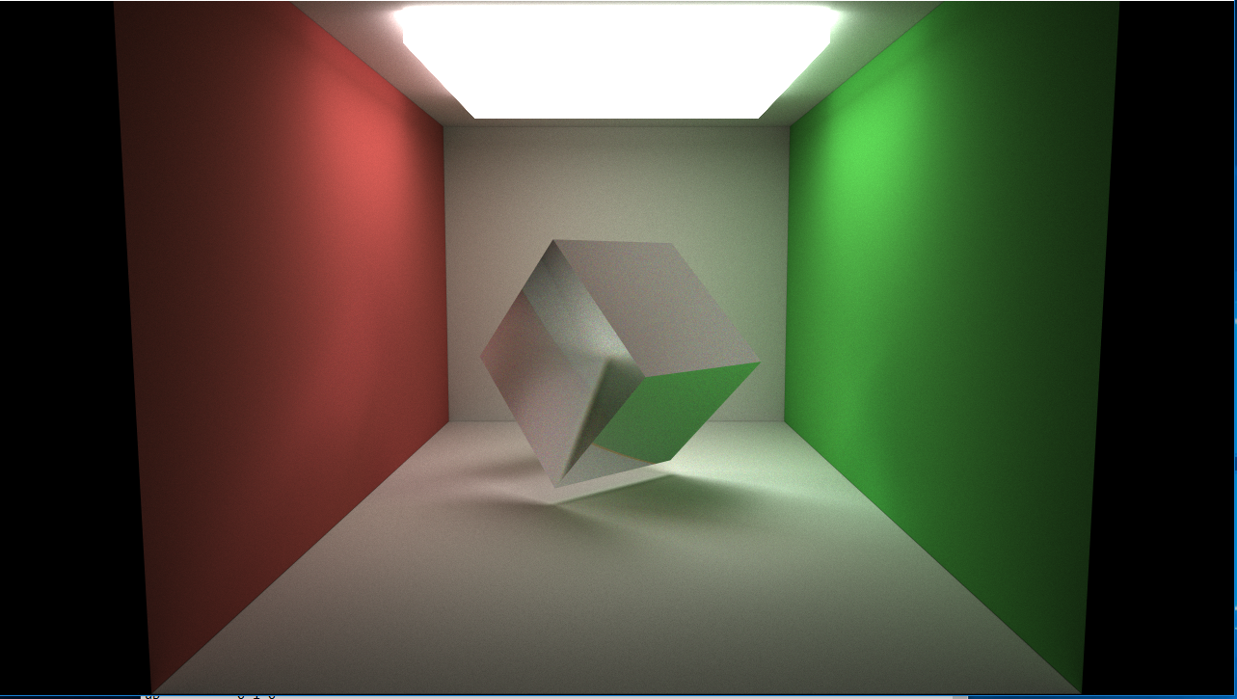

Slide 12
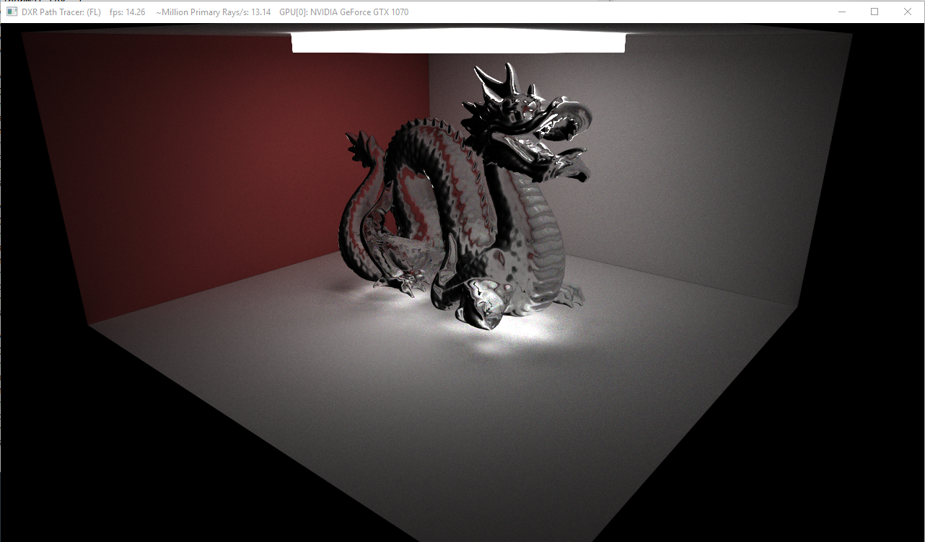

Slide 13
Upcoming Goals

Slide 14
MILESTONE Ⅳ
Optimization & Diagnosis of Bottlenecks Benchmarks and Performance Analysis Subsurface Scattering (?) Loading gltf scenes (?) Mini minecraft (?)

